Slide 1
“Whatever You Say”
Software Quality Analysis
Elangeni Yabba
Payal Narkhede
Ankit Singh

Slide 2
Introduction
The software was designed to enable communication of people in a system.
It is a suite based on interconnected but independent modules, each of which are responsible for performing an individual task.
The modules are as following:
User Directory – to view users of a system
File Server – to share files in the system
Chat – to enable real time communication among individuals and groups
Internet/Intranet – to view web based documents
Message boards – to enable group/public discussions on topics.
All modules have translators to enable communication in the user’s native language.
For this software, dynamic translation is provided through third-party internet-based translators and the assumption is that they will provide the appropriate translations.

Slide 3
Documents Provided
Administrator Manual
Setup Instructions
Feasibility Analysis
Software Requirements Specifications
Software Design Specifications
Software Design
Test Plan
User Manual

Slide 4
Feasibility Analysis
What is included?
Resource requirements
Hardware and software requirements
Proposal
Risk Analysis
Project Schedule
What is missing?
Possible competitors
Marketing Strategy
Financial Projections
Glossary

Slide 5
Set Up Instructions
What is included?
Instructions on how to install software
Instructions on how to run the client
Test username and passwords
What is missing?
Permissions of the provided users
Ways to troubleshoot if setup does not go as planned
Detailed step by step instructions

Slide 6
Administrator Manual
What is included?
Introduces the software and basic concepts
Adding new user
Updating user password
Modifying user information
What is missing?
Setting user permissions
Maintenance report
Create and maintain security procedures

Slide 7
User Manual
What is included?
Product description
Descriptions of main features
Description of how to use/operate the product
What is missing?
Maintenance/repair information
Glossary
Index
List of features

Slide 8
Coding Errors
File Name | Error Description
FileViewer.java | The program is dereferencing a field that does not seem to ever have a non-null value written to it. Unless the field is initialized via some mechanism not seen by the analysis, dereferencing this value will generate a null pointer exception.
RenameDialog.java | Read of unwritten field fileNameTF in edu.pace.WUSClient.RenameDialog.okButtonClicked(ActionEvent)
ConnectionSettings.java | Read of unwritten field tfPort in edu.pace.WUSClient.ConnectionSettings.testClicked(ActionEvent) Read of unwritten field tfServer in edu.pace.WUSClient.ConnectionSettings.testClicked(ActionEvent)

Slide 9
Java Code Convention
Code conventions improves the readability of the software.
Source files should begin with c-style comments-missing version history and copyright notice.
Unit of Indentation.
Line length.
Naming Conventions: Classes, methods, and variables.
Variable values are hardcoded-use constants.
Notes:
For better readability of the code

Slide 10
Requirement Specification
Requirement IDs should be given to the all requirements.
Priority for each requirement.
Version history needs to be updated properly.
If the new section or information is added, then in which section it is added.
Table of content is pointing to same page (page No. 4)
Notes:
Performing a requirements traceability analysis - It ensures that all of the requirements have been adequately considered during each phase of the project.
Different stakeholders will have different views of the requirements-so it is a good idea to prioritise the requirements.

Slide 11
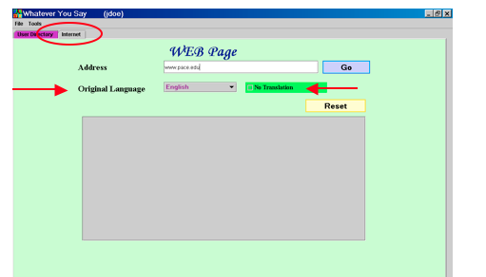
User Interface and Design
Color of the User Interface -Pink, is not comfortable.
File upload window-instead of button open there should have been button name as upload. Same for logout module.
Highlighting for tabs should have been proper.
Mechanism to quickly find a user is not implemented.
The calendar which shows national holidays and weekends for the region is not implemented.
The online status for a user who is being viewed is not implemented.

Slide 12
Suggested Improvements
Add glossary/index to documents
Add proper ID’s for requirement specification, design specification and test documents.
Update version history of the documents.
Improve the appearance of the user interface.
Add more languages.
Add ability to reset password from login page.
Tutorials/Help page.

